Slide 1

Architecting and Designing Enterprise Applications
Presented By,
M.Sangeetha,
AP(SRG)
KEC.

Slide 2

unit -3
Infrastructure Architecture and Design
  There are several expectations about the quality of service of the application - consistent user experience, enterprise data security, ability to handle vast online user base, 24/7 availability and disaster recovery to ensure business continuity.
  Infrastructure architecture ensures that these capabilities are planned for, and built into the system.
.

Slide 3
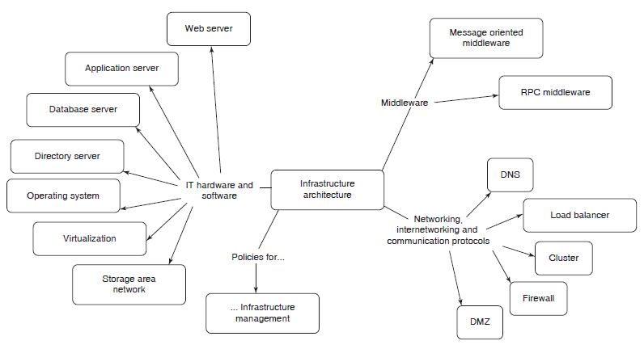
Infrastructure Architecture Building Blocks

Slide 4
Networking, Internetworking and Communication Protocols
  The connectivity across all the locations and devices is supported by the ‘networking, internetworking and communication protocols’ building block of the infrastructure architecture.
  A few of the key elements:
  DNS: An Internet or intranet enterprise application is accessed via a URL (Uniform Resource Locator), which is mapped to a specific IP address. This mapping is provided by a Domain Name Server (DNS).
  Load Balancer: Available both as hardware and software, helps in splitting the traffic to ensure the scalability of an enterprise application.
Contd….

Slide 5
Networking, Internetworking and Communication Protocols (Contd…)
  Cluster: Helps to ensure the availability and performance of an enterprise application.
  Firewall: Used to achieve the security at the network level.
  DMZ (Demilitarized Zone): Also known as perimeter network, is a sub network of an organization, which provides access to the external facing services of an enterprise to the outside world.
.

Slide 6
IT Hardware and Software
  IT Hardware and Software is the core building block of infrastructure architecture, which comprises of several elements such as operating systems, servers, storage mechanisms, communication mechanisms and application platforms.
  A few key elements in this building block are:
  Operating System: provides a complete set of facilities to manage the hardware and software resources.
  Database Servers: Provides data related services such as efficient storage, search and retrieval, data integrity, security and transaction support.
Contd….

Slide 7
IT Hardware and Software (Contd…)
  Web Server: The server which accepts HTTP/HTTPS requests from a browser, and services them by interacting with other tiers.
  Application servers: The core business logic of an application is hosted on an application server.
  Virtualization: mechanism to abstract IT infrastructure. It can be viewed as a design pattern in the IT infrastructure landscape, and is implemented at different levels like platform or system resource level.

Slide 8
Middleware
  Middleware is the software glue which binds together the software pieces of a distributed application, and enables integration of discrete enterprise applications and their components.
  It is used to enable interoperability and enhance reliability of applications.
Contd….

Slide 9
Middleware (Contd…)
  Middleware can be categorized into the following types:
  Message Oriented Middleware (MOM): based on a client/server architecture and is used for reliable transport of messages across heterogeneous, geographically distributed systems.
  Remote Procedure Call (RPC): provides a mechanism for invocation of procedures on a remote server in a way identical to invocation of local procedures, by completely hiding the details of the underlying network.

Slide 10
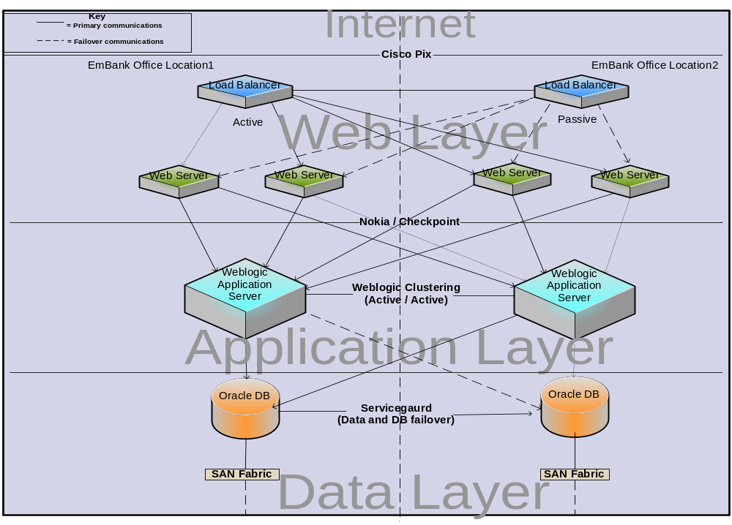
Deployment Strategy

Slide 11
Architecture and Design Documentation
  The architecture of an enterprise application is documented in the System Architecture Document (SAD).
  The term high level design is also used interchangeably with SAD.
  It acts as a blueprint for the detailed design process.
  The detailed design of an enterprise application can be documented in several ways - technical layer wise, module/use case wise, component wise, or typically a mix of them.
Contd….

Slide 12
Architecture and Design Documentation (Contd…)
  The overall objective of the design documentation is effective communication among application teams which are involved in design, development and deployment activities.
  The design documentation should include, for each use case, the presentation, business and data access components.
  In addition to this, integration and database designs may be documented separately.

Slide 13
Key Elements of SAD
SAD Element | Description
Goals of the architecture | principles
Solution constraints | Constraints to be met in the architecture
Logical Architecture | Logical representation of all layers
Quality of services | NFRs
Interface/ integration requirements | Information about external systems
Technology selection | Tools, technologies, frameworks
Technical architecture | Technical solution
Data architecture | Business entities and relationships
Infrastructure architecture | h/w, s/w, middleware, network topologies
Contd….

Slide 14
Key Elements of Presentation Layer Design Document
SAD Element | Description
Screen mockups | Wireframes, UI layout, screen templates and event handling
Error handling | Recovery actions in the event of errors and messages
Input validation | Rules for validating user input data on both client and server side
Contd….

Slide 15
Key Elements of Business and data access layer Design Document
SAD Element | Description
Business delegate | Captures set of methods that need to be invoked
Session façade | Captures the list of services that need to be grouped
Business service | This captures the business interfaces and their implementation details
Business Model | This captures the business entities and their interrelationships
Data Access Layer components | This includes the design details of data access components, object relational mappings etc.

